Slide 1




Ecommerce sentiment analysis for customers' review
By sept 2023 internship group 2

Slide 2

introduction
Amazon has a mission to be Earth’s most customer-centric company, Earth’s best employer, and Earth’s safest place to work.
The company is guided by four principles: customer obsession rather than competitor focus, passion for invention, commitment to operational excellence, and long-term thinking
This project is aimed at offering a comprehensive analysis of sentiment trends across various product categories on this e-commerce platform.
The development of a sentiment analysis model adept at classifying customer reviews into positive, negative, and neutral sentiments.
To analyzed if Amazon is committed to its Mission statement of being customer-centric and committed to operational excellence.

Slide 3
Objectives
To discern sentiment trends across diverse product categories.
To engineer a robust sentiment analysis model for review classification.
Develop sentiment analysis model to classify reviews as positive, negative, and neutral.

Slide 4
scope
In the data collection and preparation stage, the data engineer is responsible for collecting, cleaning, and preparing the necessary data for analysis. This involves implementing web scraping to gather customer reviews, including text content, ratings, and product categories. The collected data is then cleaned and preprocessed, handling text normalization and removing irrelevant information.
In the sentiment analysis modeling stage, the data scientist develops a sentiment analysis model using natural language processing (nlp) techniques and machine learning algorithms. The model is trained and validated using labeled data, aiming for high accuracy in sentiment classification.
In the report and visualization stage, the business analyst creates visualizations and reports showcasing sentiment trends, highlighting positive and negative aspects of products. The business analyst collaborates with the data scientist to interpret model results and insights.

Slide 5
Methodology
Import necessary python libraries.
Load data from amazon.Com.
Assess the data's quality and structure.
Clean and preprocess the data.
Conduct exploratory data analysis (EDA).
Implement natural language processing (NLP) techniques for sentiment analysis.
Build and evaluate the sentiment classification model.

Slide 6


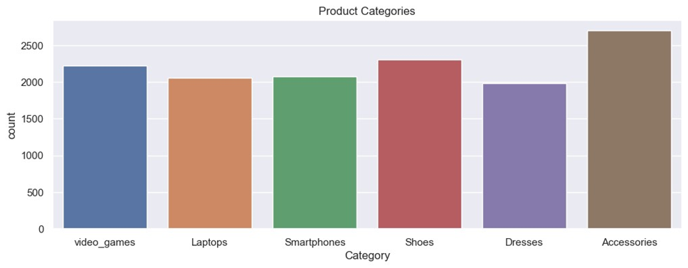
Insight:
Accessories has most customer interaction, shoes and video games, the remaining three categories of laptops, smartphones and dresses have similar customer interaction.

Slide 7
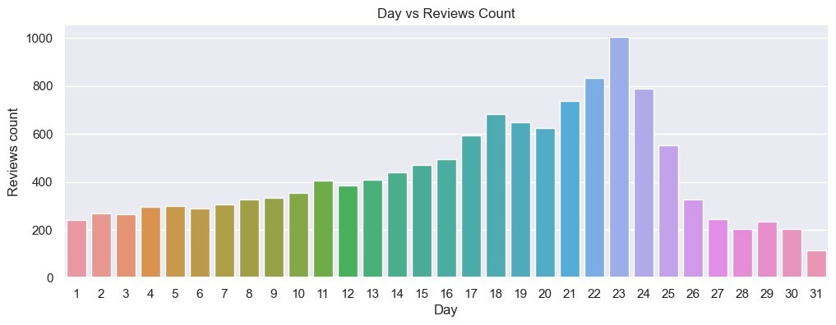
Insight: Customer reviews are high around the 17th to 24th days of the months but dwindle at the ending and beginning days of the month.

Slide 8
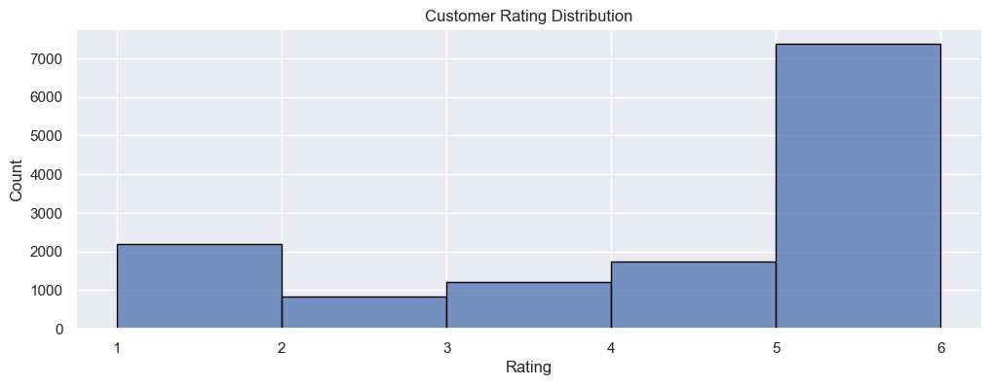
Insight: Most customers rate products highly with high rating for 5 though there are significant rating 1 which represent negative view of products.

Slide 9
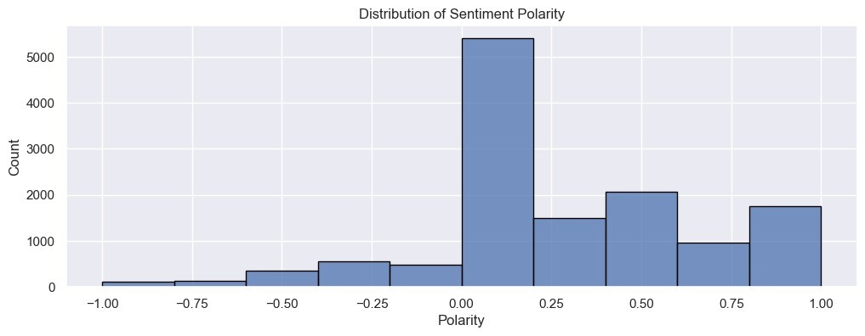
Insight: The polarity represent sentiment of customers, and this chart buttress the customers positive view of products with the polarity been positively skewed.

Slide 10
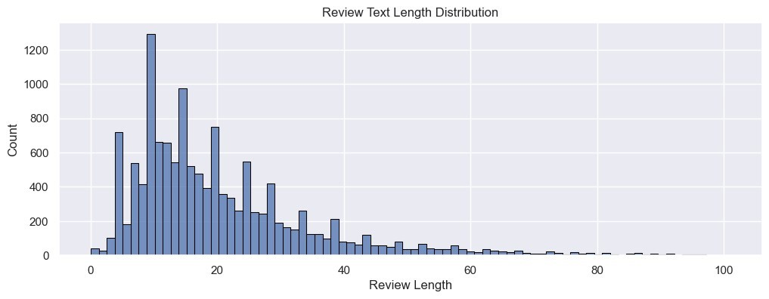
Insight: Review text length is rightly skewed with customers usually review length usually falling between 0 and 60 letters count.

Slide 11
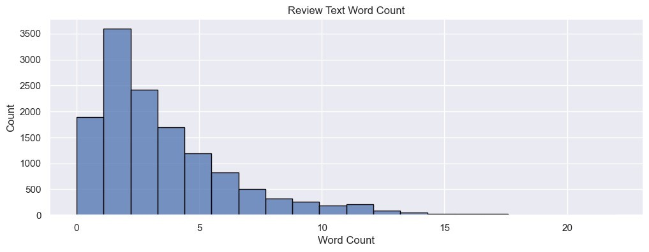
Insight: Review word count is rightly skewed with review words less than 20 among all customers.

Slide 12

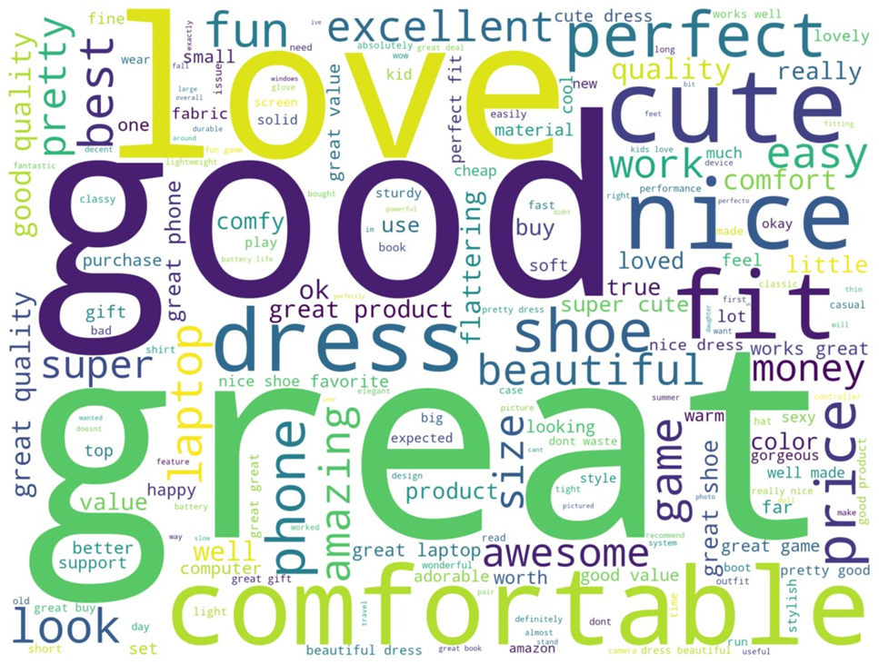
Word Cloud Review : Positive

Slide 13
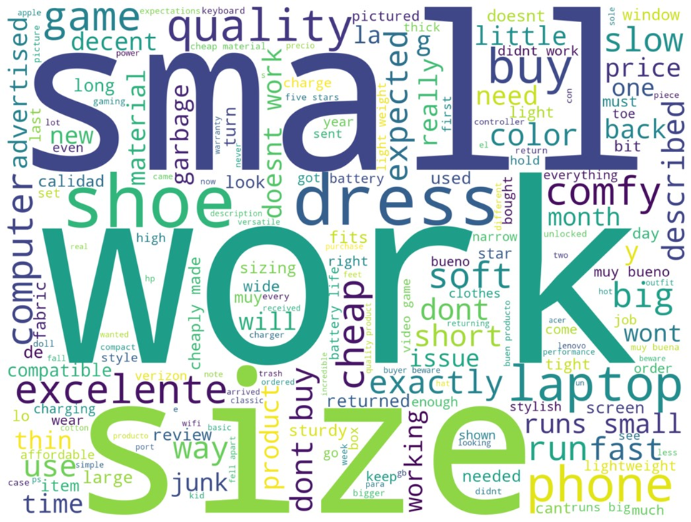
Word Cloud Review : Neutral

Slide 14
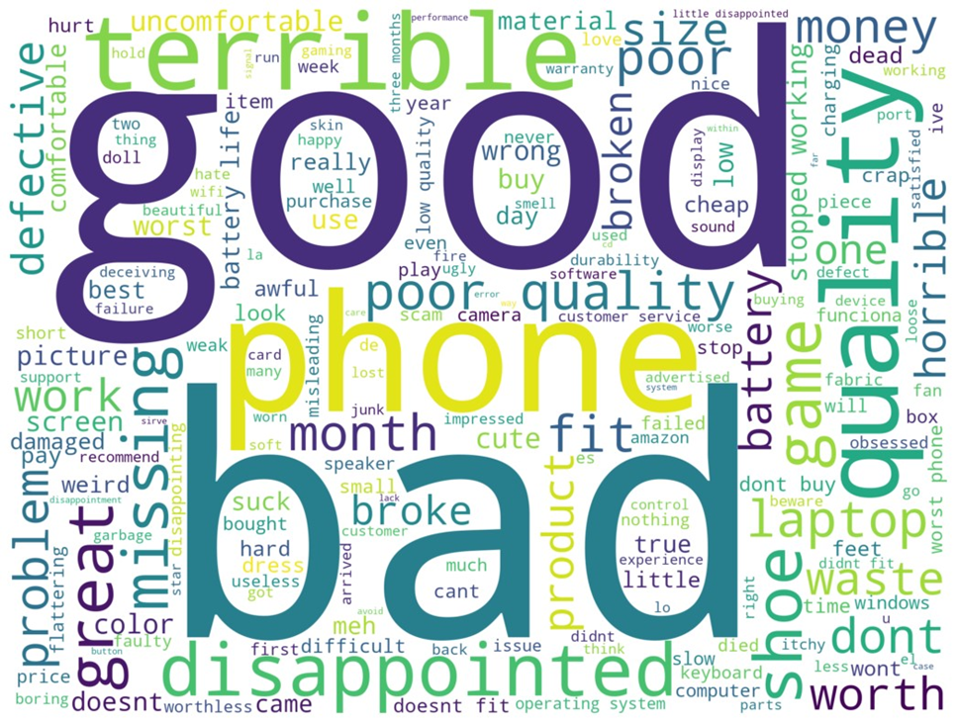
Word Cloud Review : Bad

Slide 15
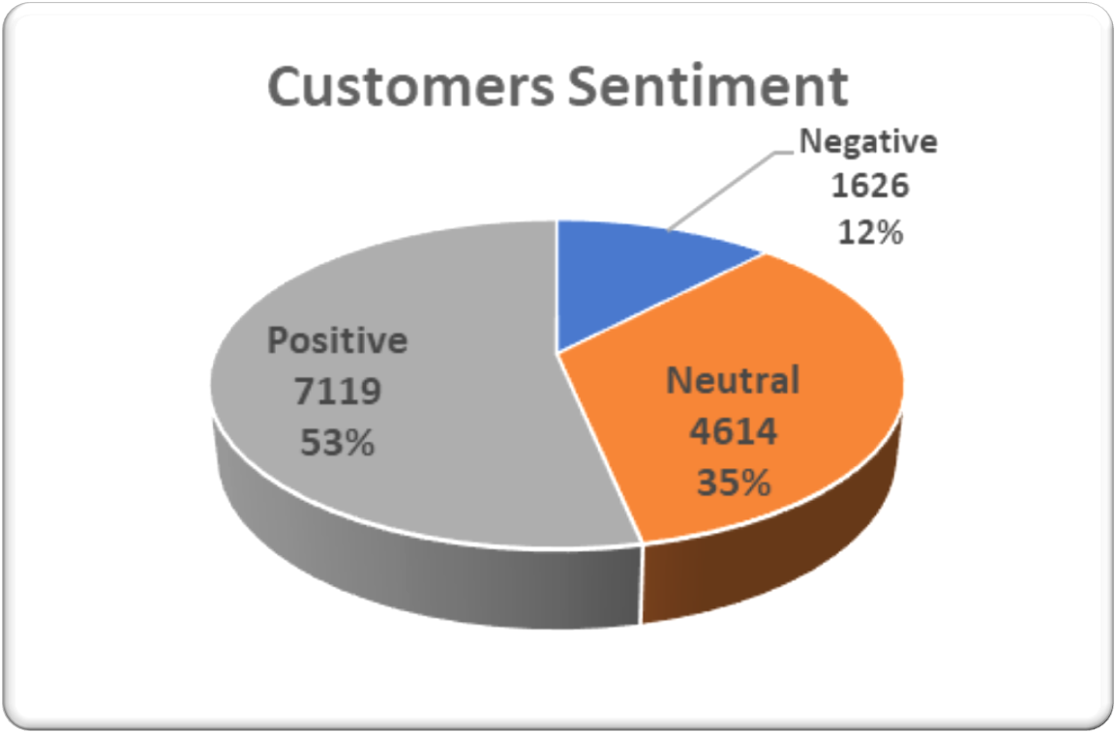
Insight: Negative view is the lowest with 12% of the analyzed 13,359 reviews, while positive is 53% and Neutral is 35%.

Slide 16
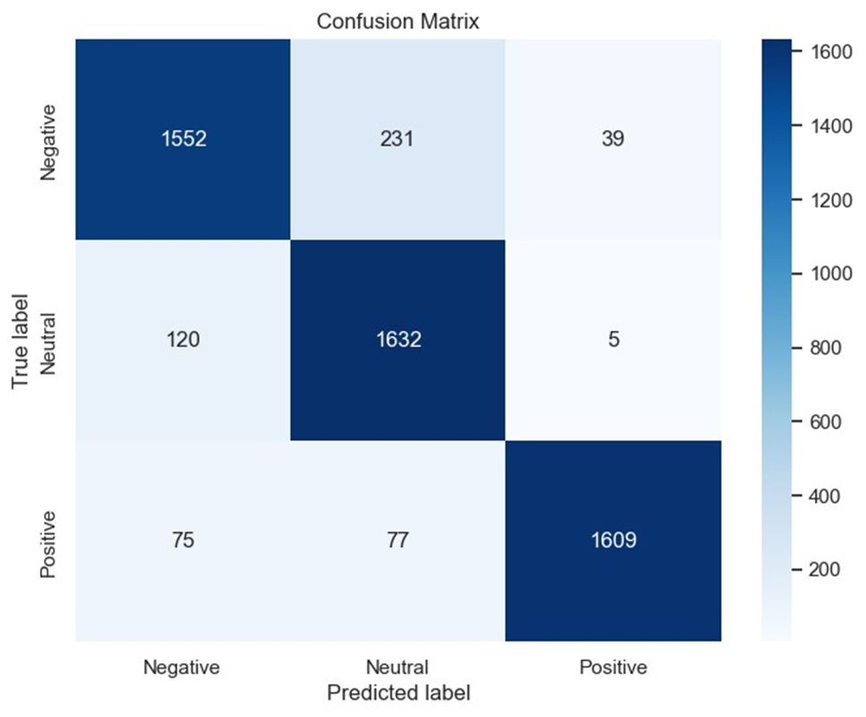
Sentiment Model
The diagonal elements (1552 + 1632 + 1609) are the correctly predicted instances by the model and rest are incorrectly classified by the model.

Slide 17



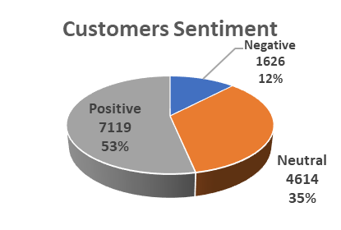



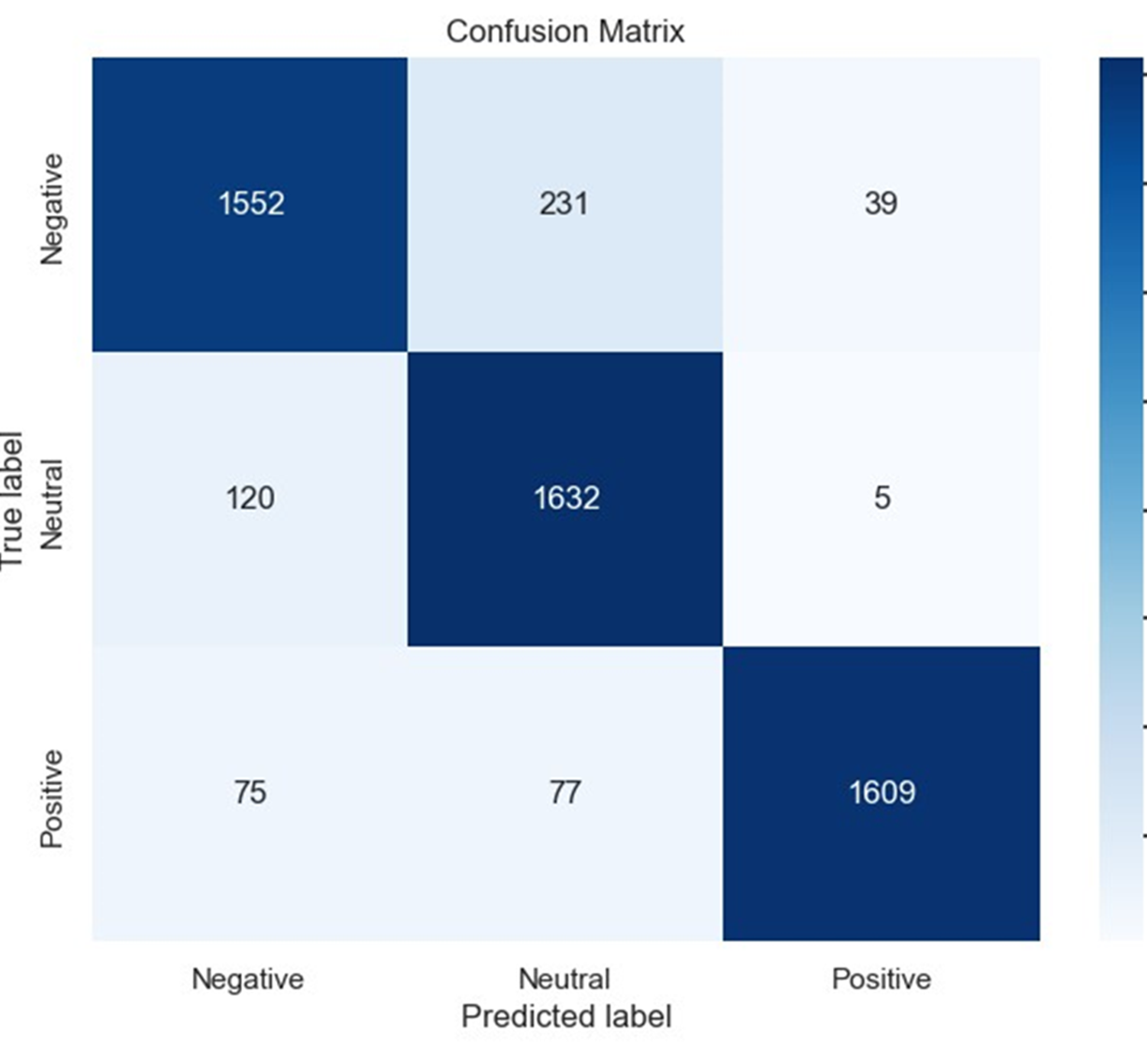
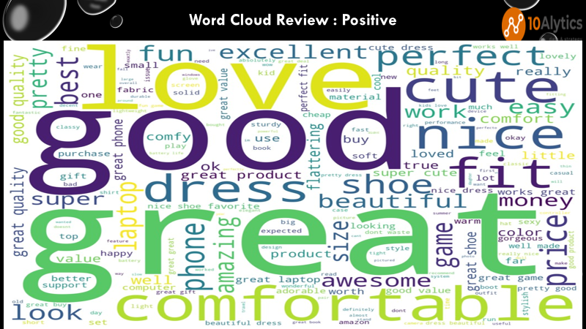
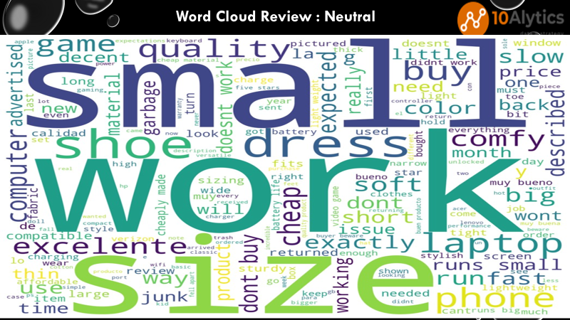
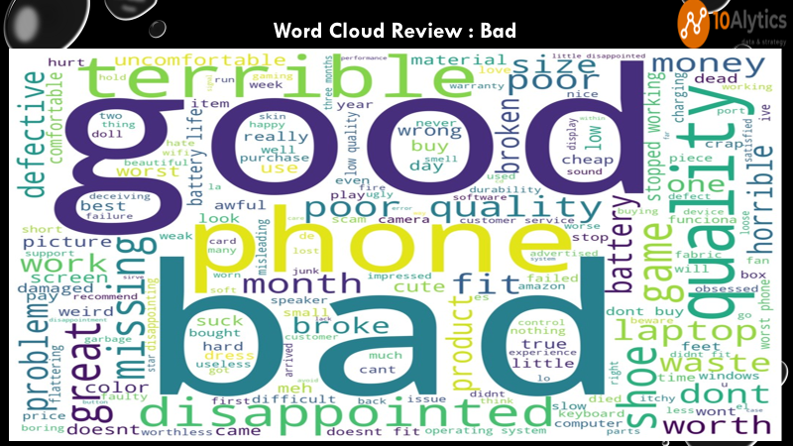


Slide 18
CONCLUSION
We have developed a sentiment model that can detect confusion with 90% accuracy, indicating a good balance between precision and recall. The model automatically classifies sentiments in reviews, providing valuable insights into customer feedback.
Our analysis of monthly sales trends revealed that there is an increase in reviews from the 17th to the 24th day of each month, while reviews dwindle at the beginning and end of the month. This information provides valuable insight into the period of the month when marketing campaigns should be at their peak, which is between 25th and 16th of the next month.
Our findings indicate that accessories have the most customer interaction, while shoes and video games have similar customer interaction. This trend suggests that these products are the revenue drivers, and campaigns can be targeted at these products.
Despite Amazon’s mission statement of being customer-centric and having operational excellence, there is still room for improvement. Negative reviews account for only 12% of the total sentiments analyzed, while positive reviews can still be improved with just 53% of the 13,359 sentiments analyzed.
https://drive.google.com/file/d/12IJX1A8WIqoz6t8GjmRpFl6YuQaWKPjG/view?usp=sharing

Slide 19

Thank you.

